Slide 1
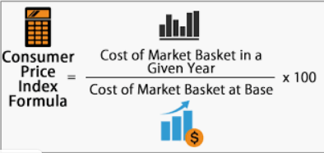
TO PREDICT CPI IN REAL TIME
WHAT IS CPI?
The CPI(Consumer Price Index) measures the average change in prices over time that consumers pay for a basket of goods and services, commonly known as inflation.
Essentially it attempts to quantify the aggregate price level in an economy and thus measure the purchasing power of a country's unit of currency.
The weighted average of the prices of goods and services that approximates an individual's consumption patterns is used to calculate CPI.
SIGNIFICANCE OF CPI
CPI is widely used as an economic indicator. It is the most widely used measure of inflation and, by proxy, of the effectiveness of the government’s economic policy. The CPI gives the government, businesses, and citizens an idea about prices changes in the economy, and can act as a guide in order to make informed decisions about the economy.
INTERNAL

Slide 2
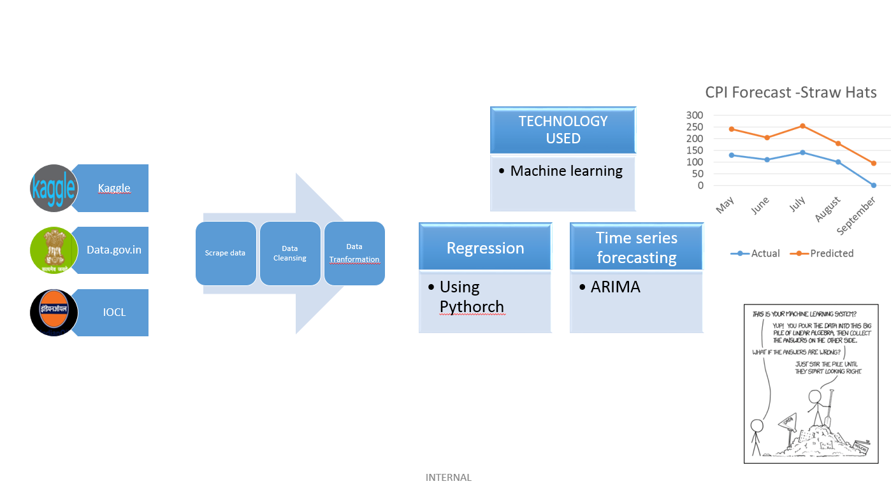
DATA SOURCES
INTERNAL

